Slide 1

PASSENGER VEHICLE MANAGEMENT SYSTEM
Prof D.Jyothsna Prof K.yellaswamy

Slide 2
Team Members
Srinivas (190330213)
Rajesh V (190330307)
3) Jayanth M (190330306)
4) Hemanth N (190330308

Slide 3
Project Description
This system provides an online tool for the people to Buy ,Sell vehicles in website of any category created by admin. In this system, there will be two main pages to be able to access: Admin page and user Page.
From the Admin, page administrator will be able to create the user and can get result from any category ie sell , buy.
The Seller can sell their vehicles by posting it on the website.
A Buyer can buy the vehicle which is posted by the Seller in the website.
Modules included in this project are Admin, User(Seller,buyer).

Slide 4
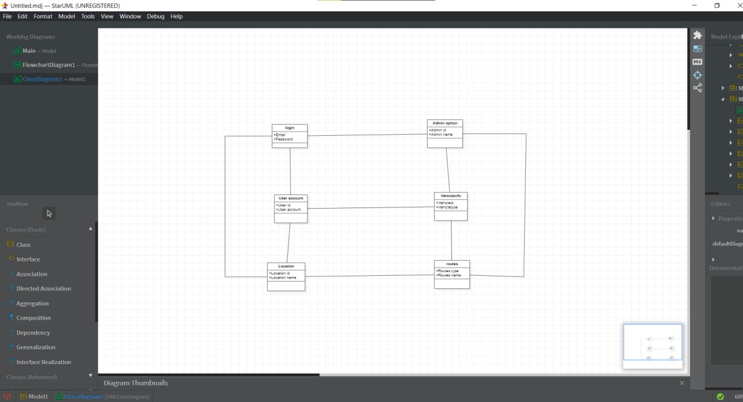
Class Diagram

Slide 5
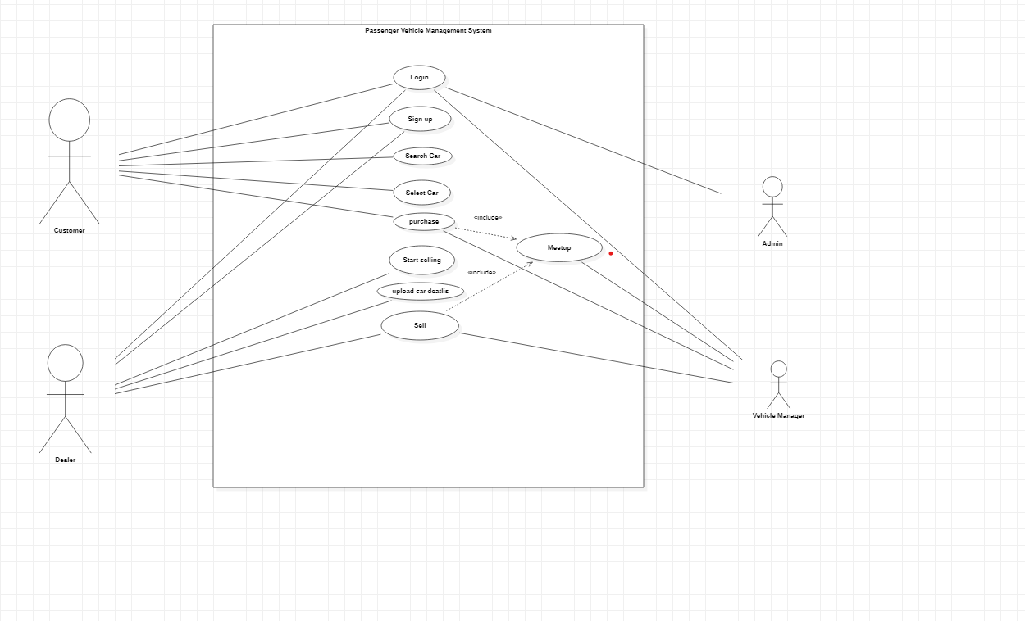
Use case diagram

Slide 6
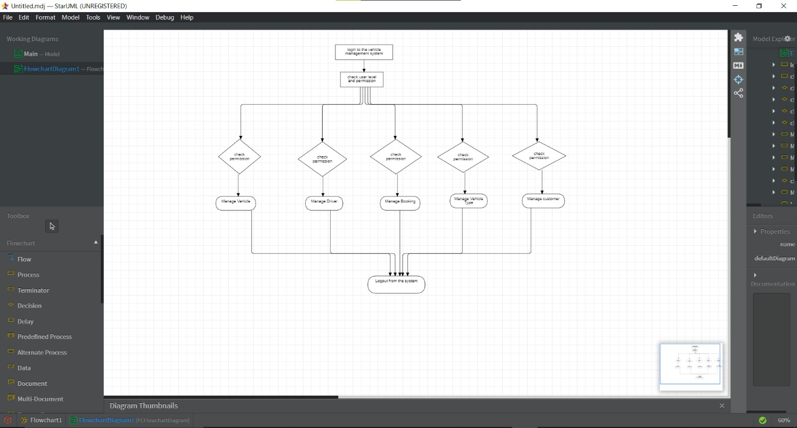
Flow Chart

Slide 7
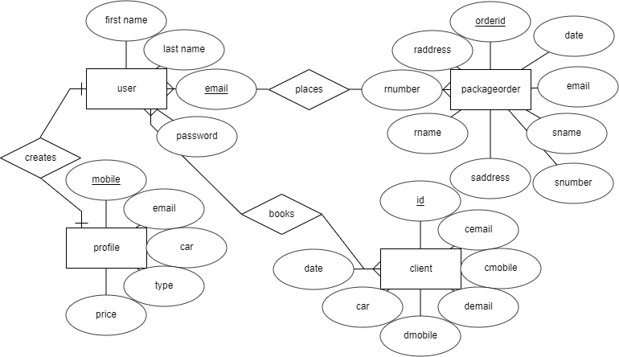
Er DIAGRAM

Slide 8
Technologies used
For our project we have used following technologies
Frontend is developed using following technologies
1)Html (Hypertext Markup Language)
2)Css(Cascading Style sheets)
3)Jsp(Java Server Pages)
4) BootStrap
Backend is developed using following technologies
1)Servlets
2)Mysql

Slide 9


Ide’s used
Ide stands for integrated development environment which provides tools to build applications easily
Following are the ide’s used in our project
1)Eclipse
2)Visual studio code

Slide 10
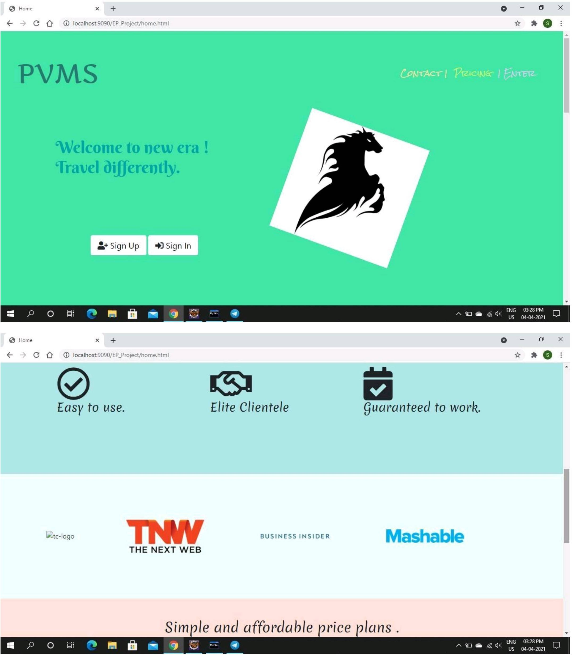
Home.html

Slide 11
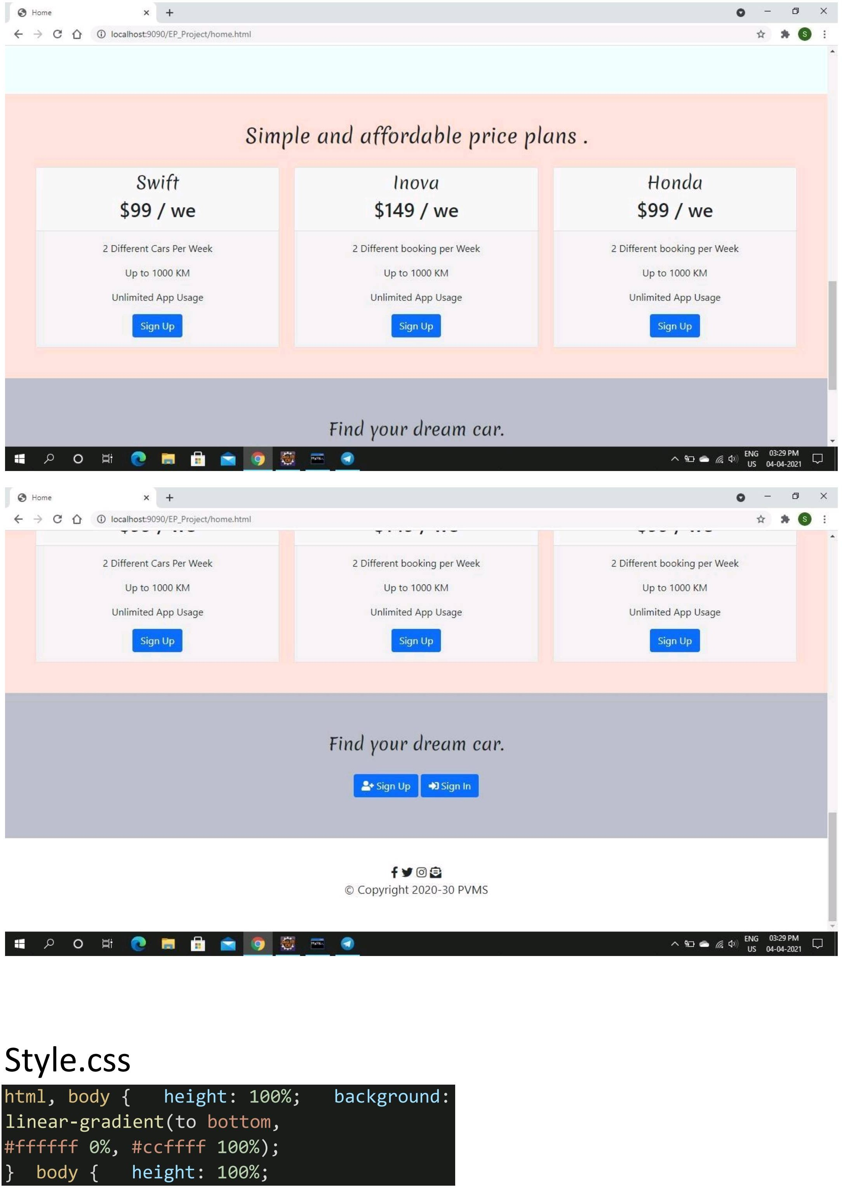

Slide 12
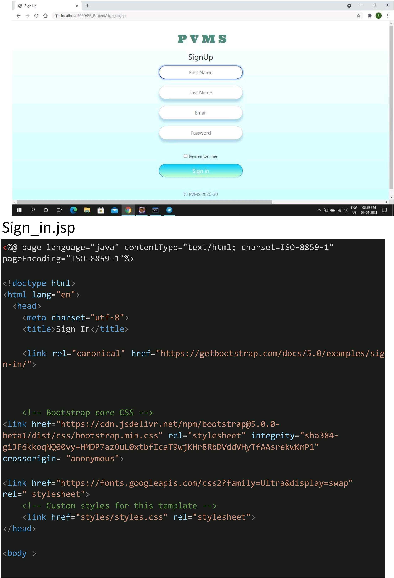
Signup

Slide 13
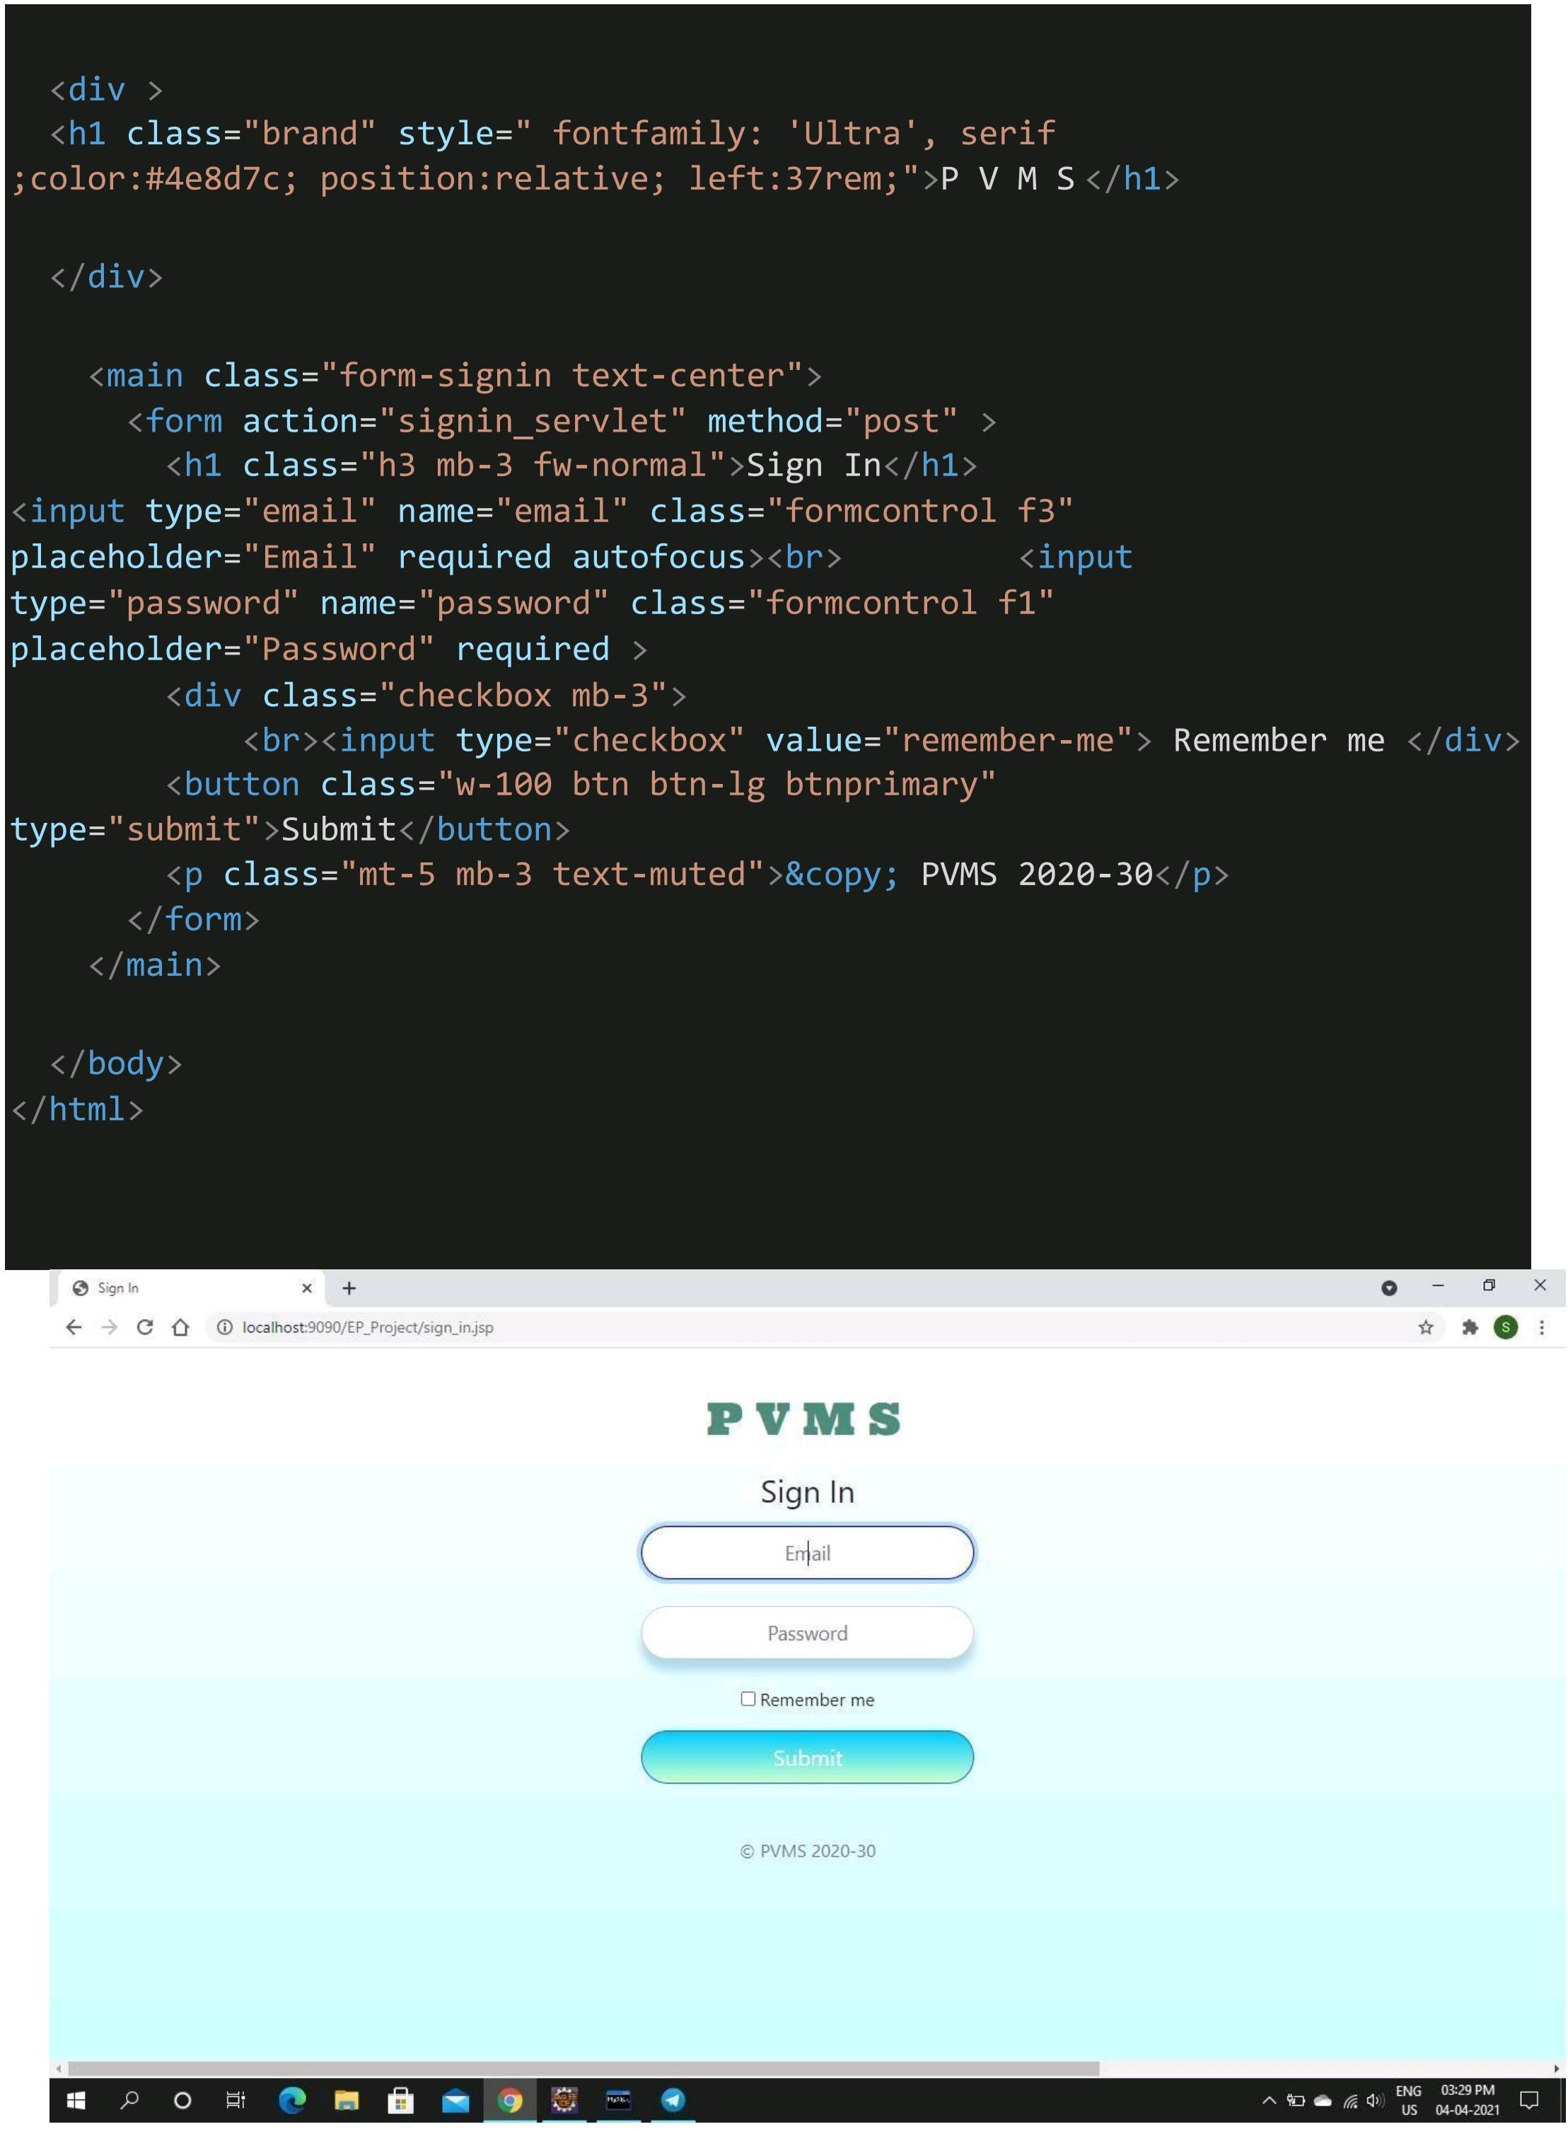
Signin

Slide 14
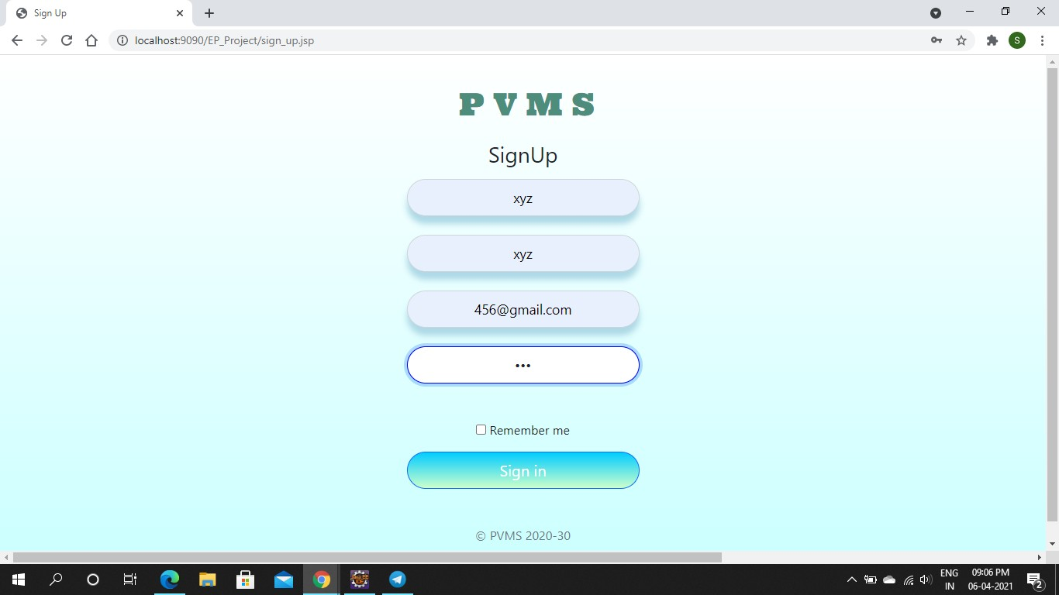
New User Sign

Slide 15
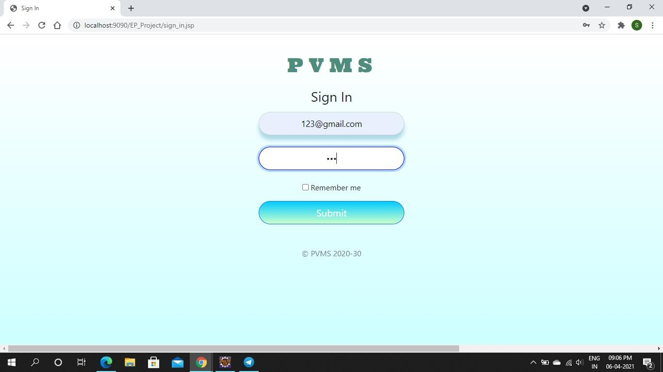
Existing User Signin

Slide 16
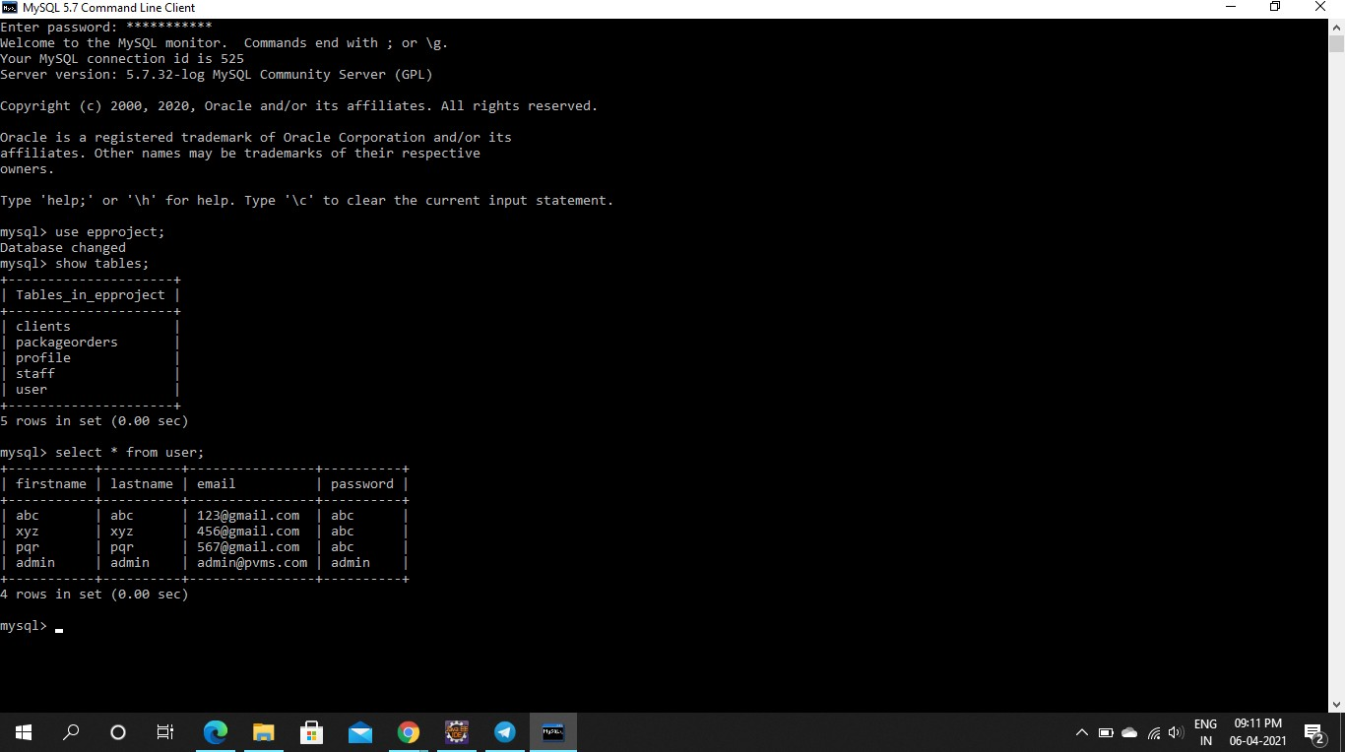
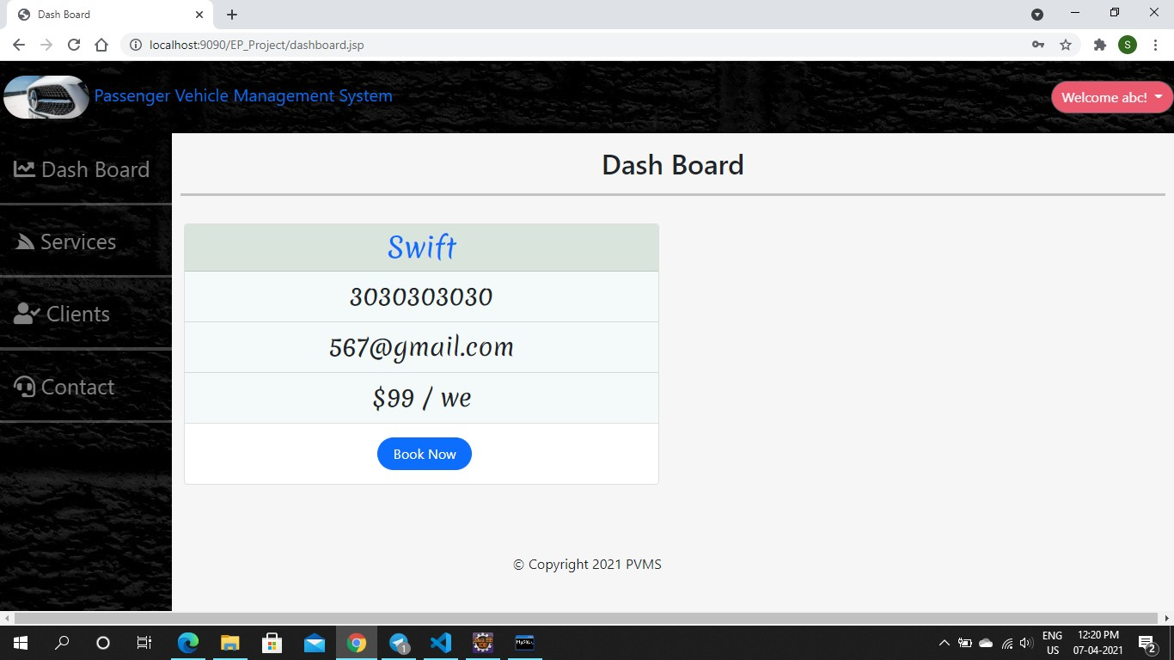
Database(Mysql)
Customer Module

Slide 17
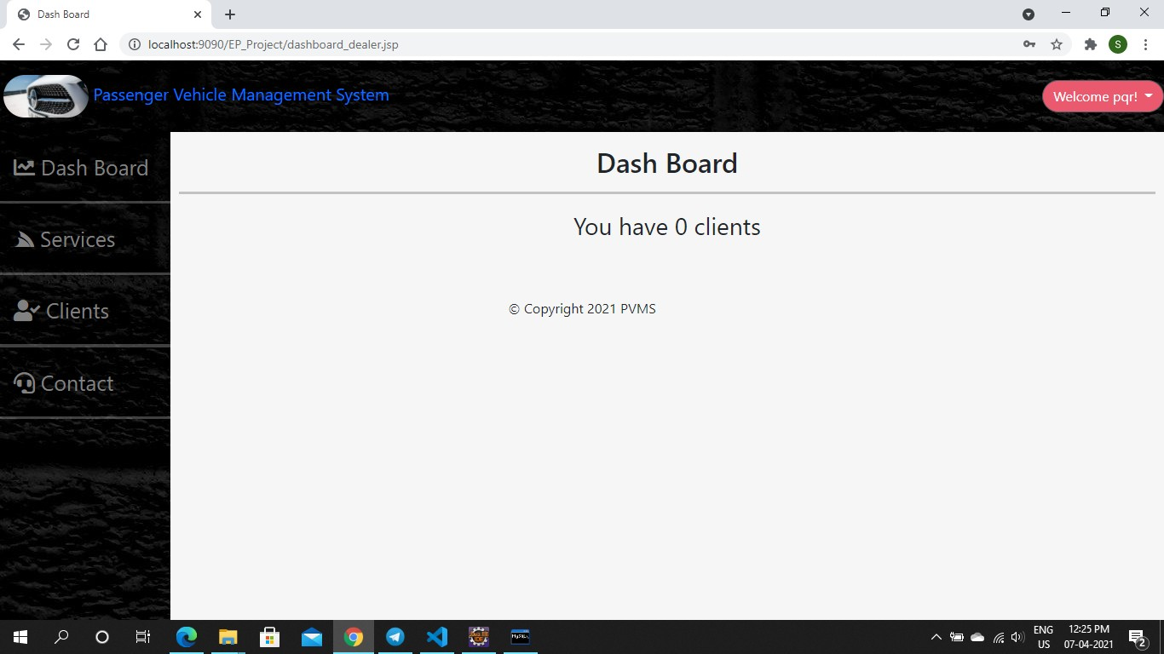
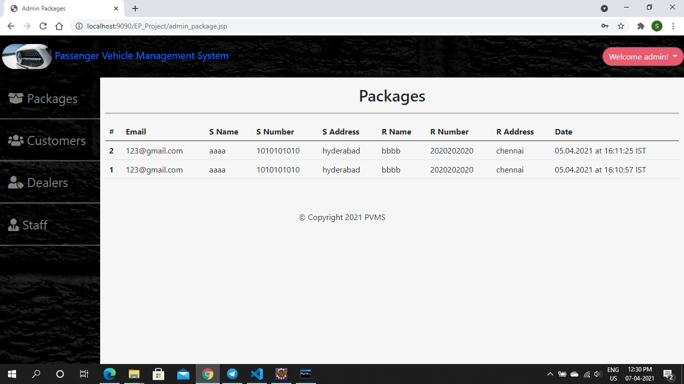
Dealers Module
<%@include file="../partials/footer.jsp"%>
Admins Module

Slide 18
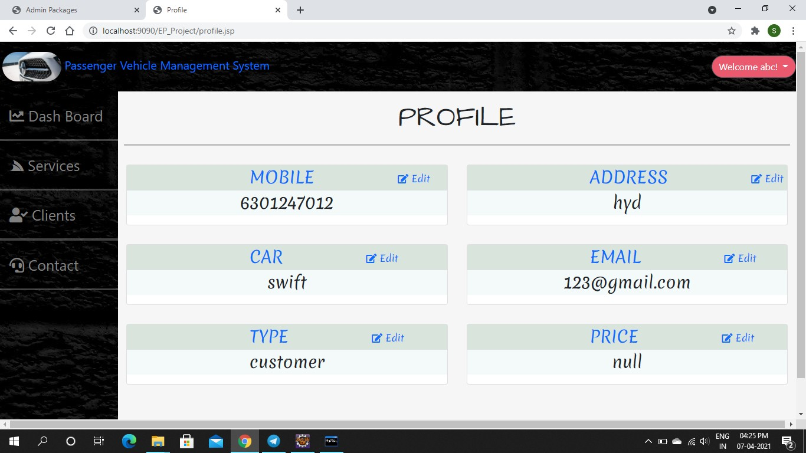
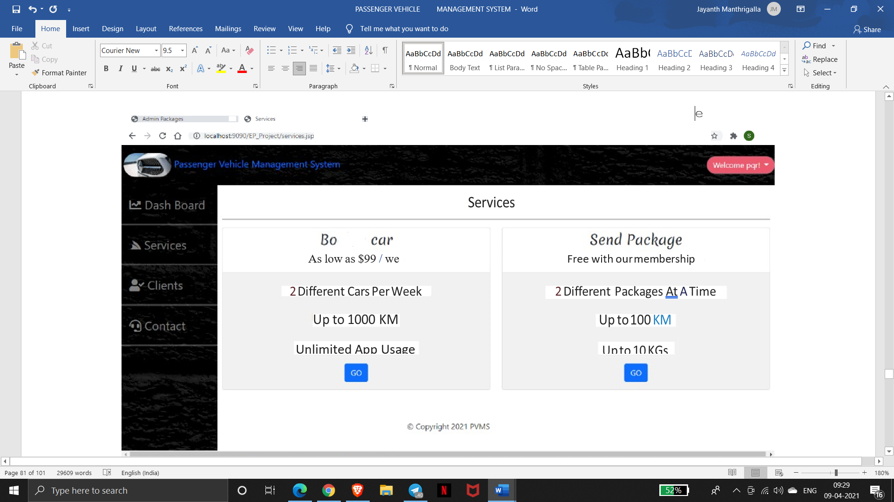
Customer Module (Profile )
Packages

Slide 19
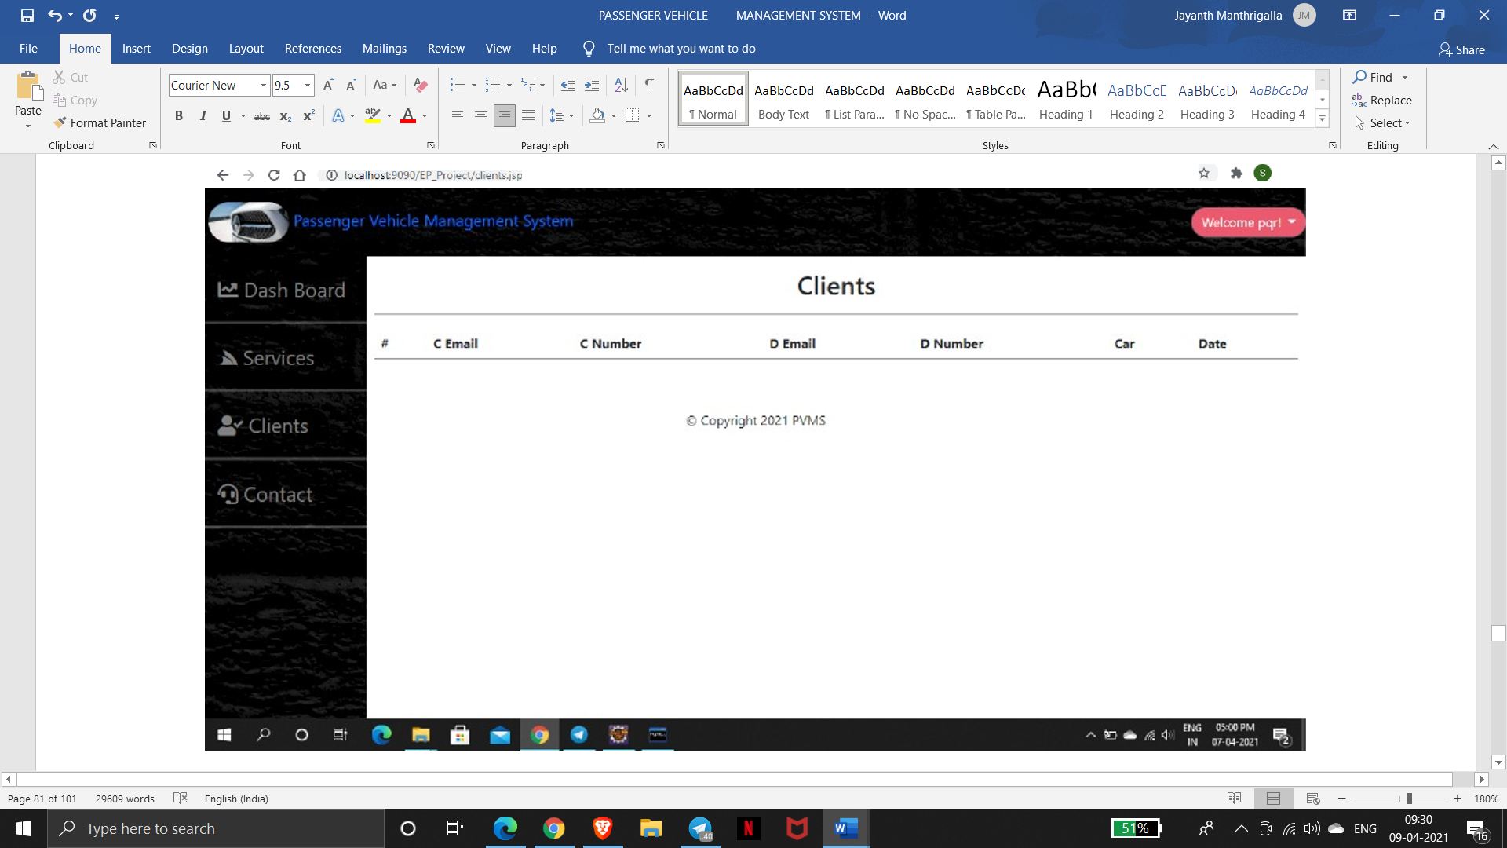
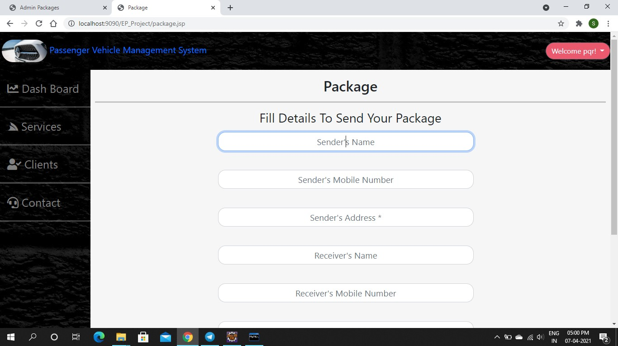

Slide 20
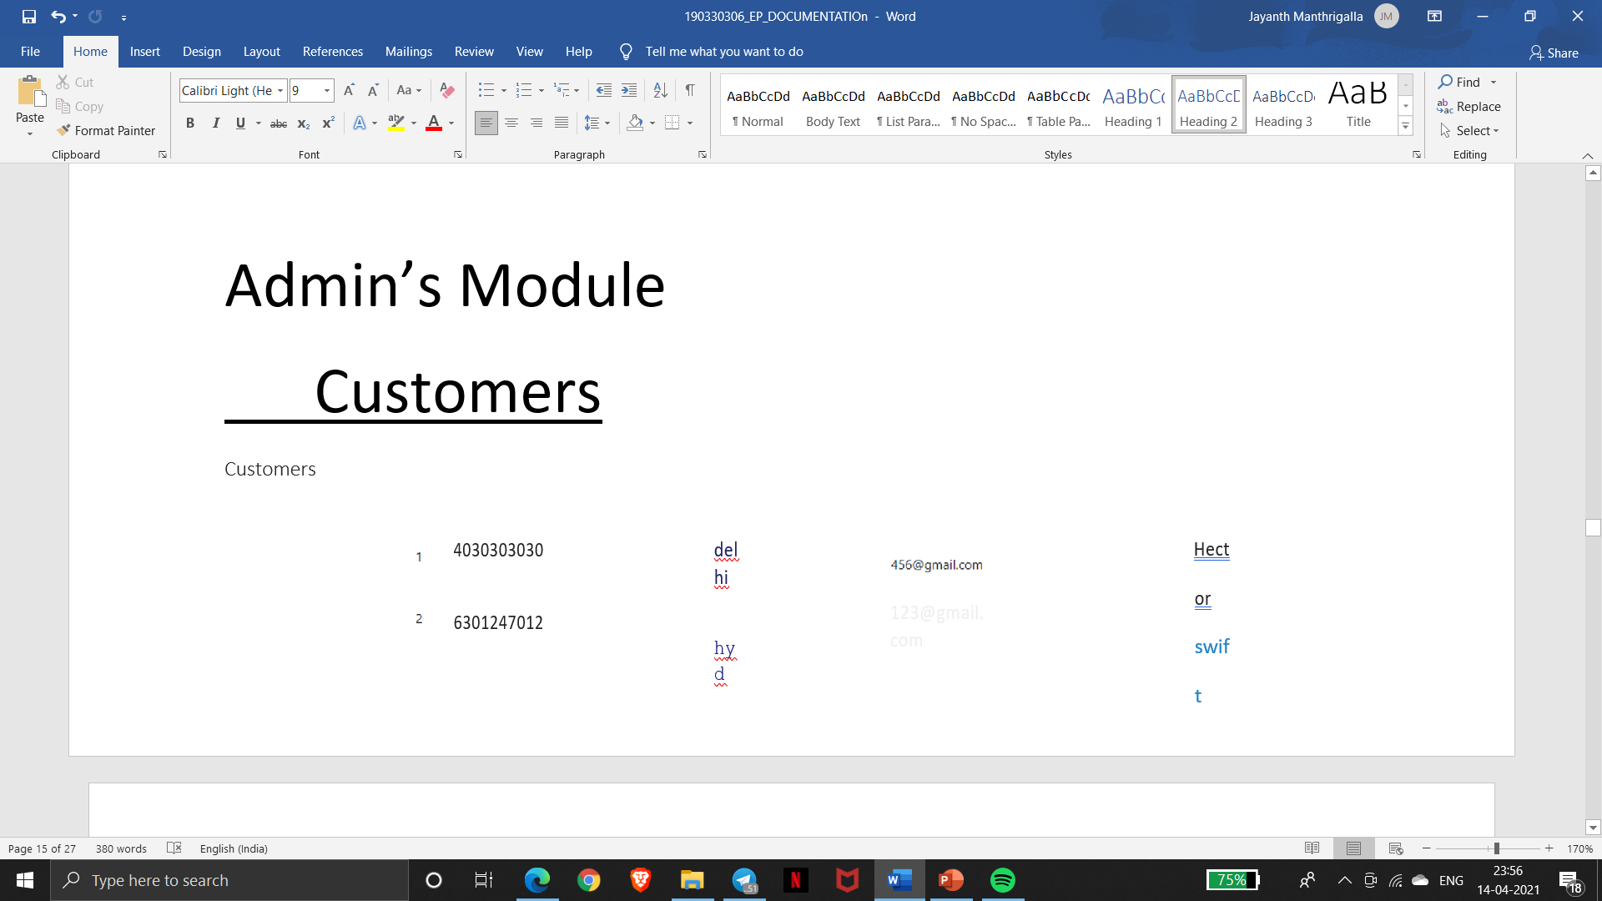
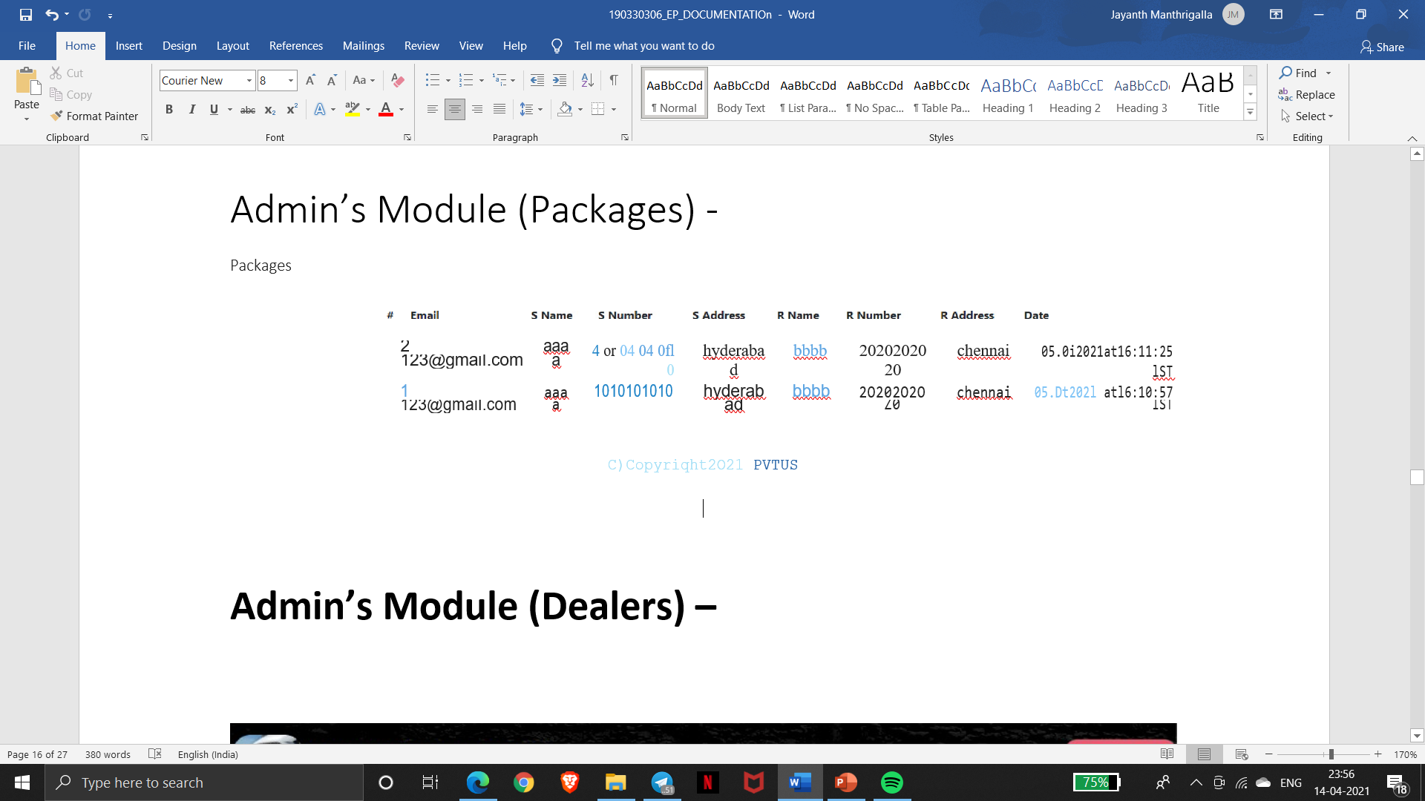
Admin’s Module
Customers
Admin’s Module (Packages)

Slide 21
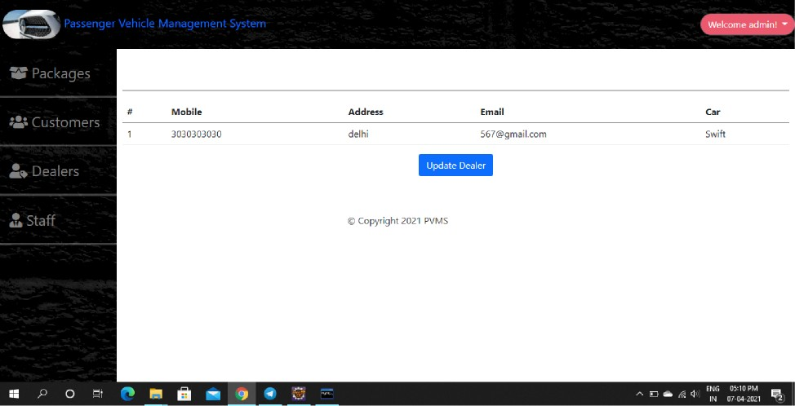
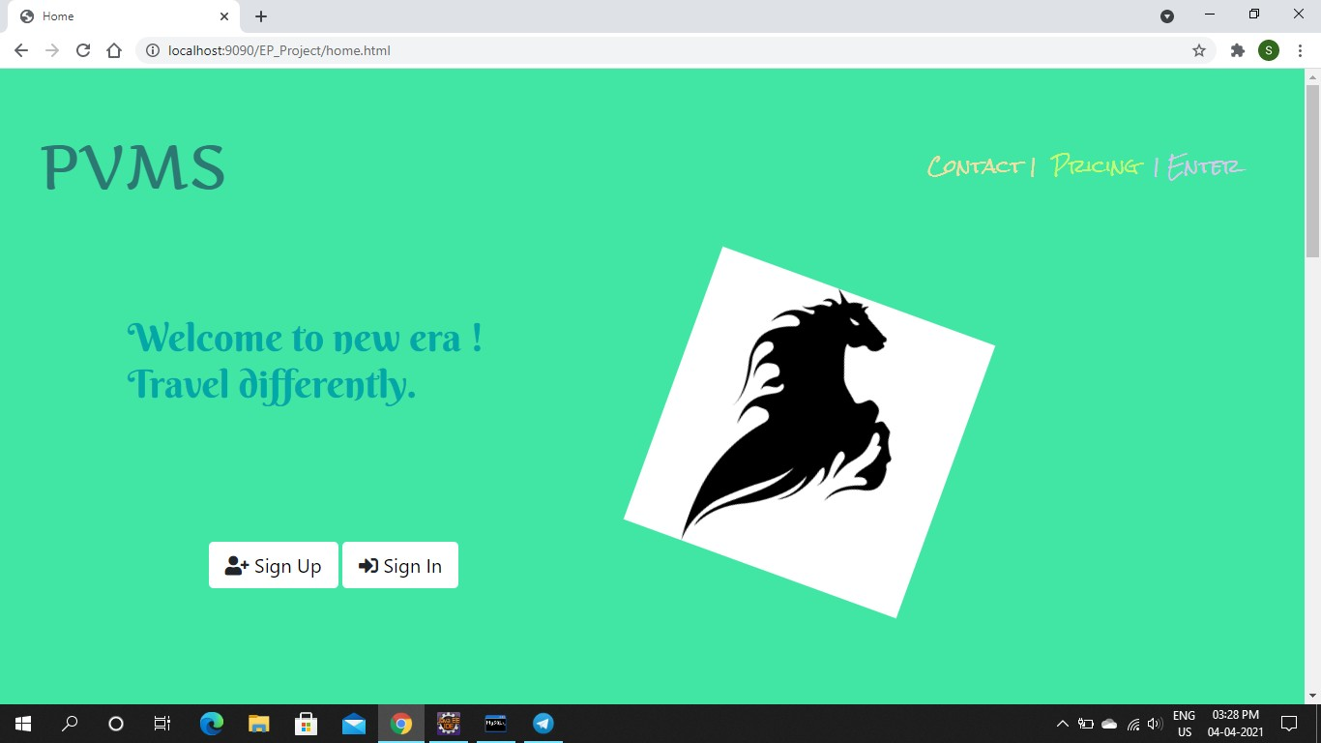
Admin’s Module (Dealers)
Customer’s Module:-
Signing up and creating customer’profile:-

Slide 22
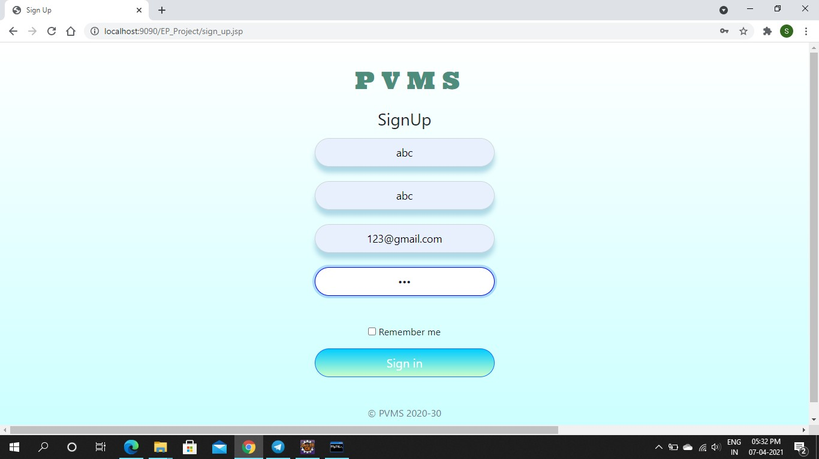
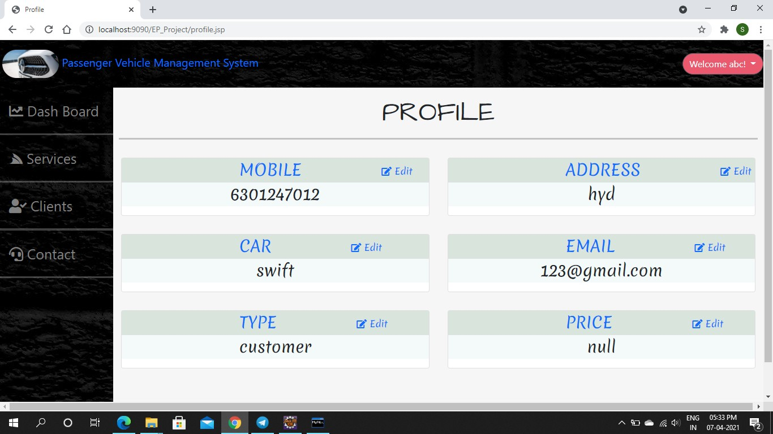
2)
3)

Slide 23
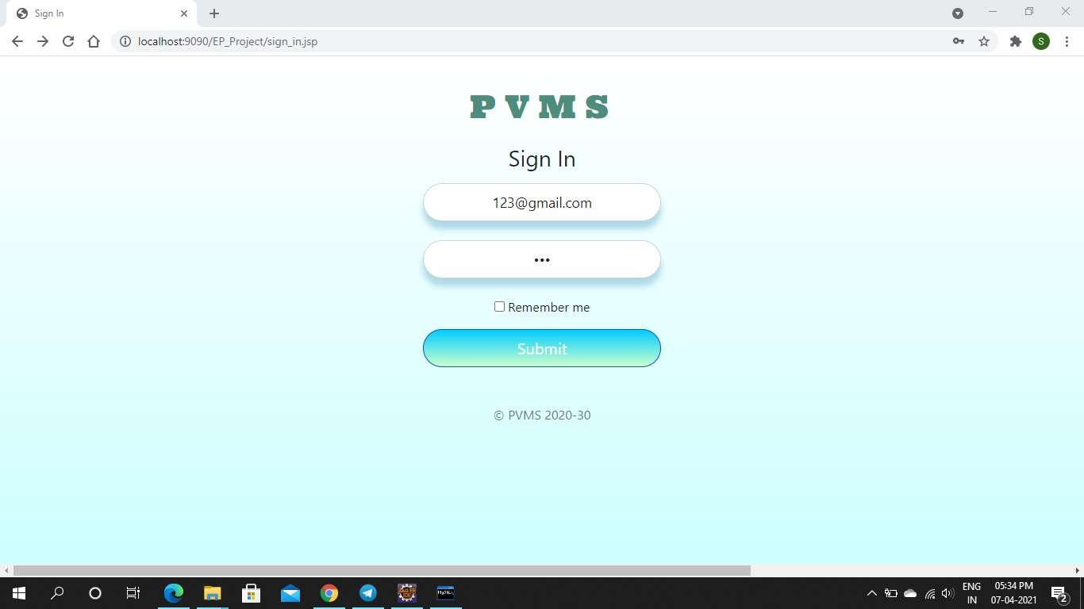
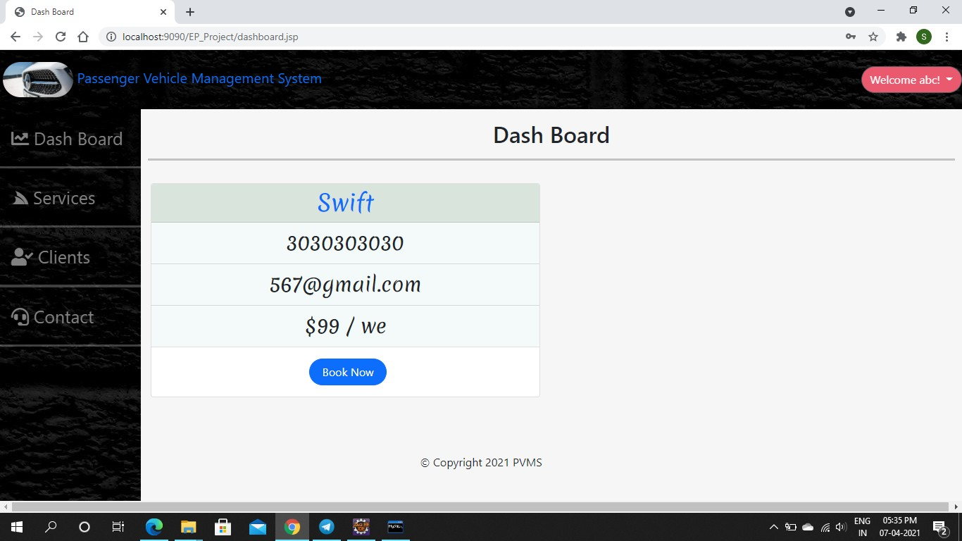
Next, loging out and signing again
4)
5)

Slide 24


Signing up and creating dealer’s profile
2)

Slide 25
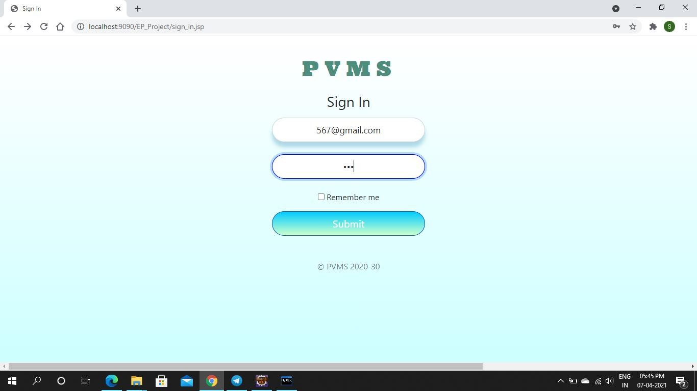

3)

Slide 26
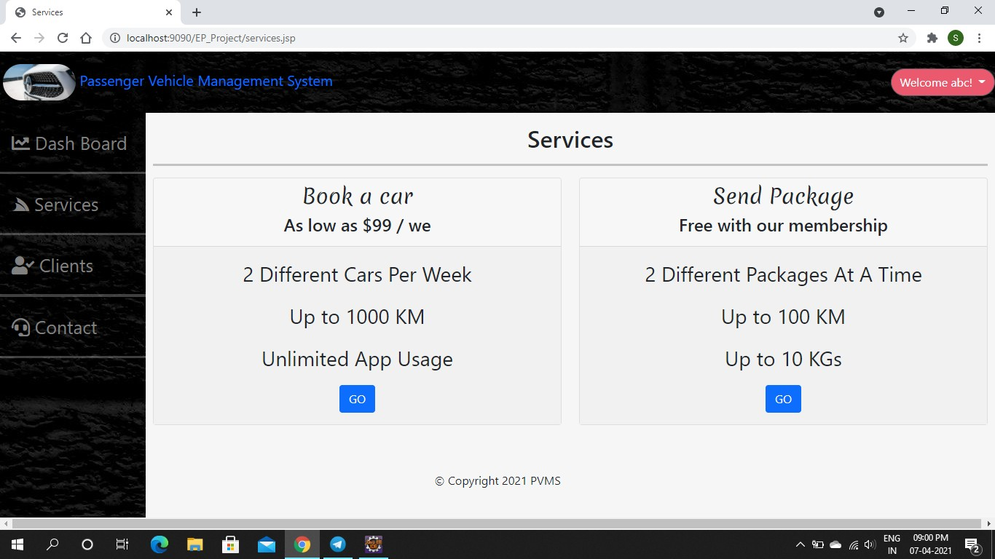
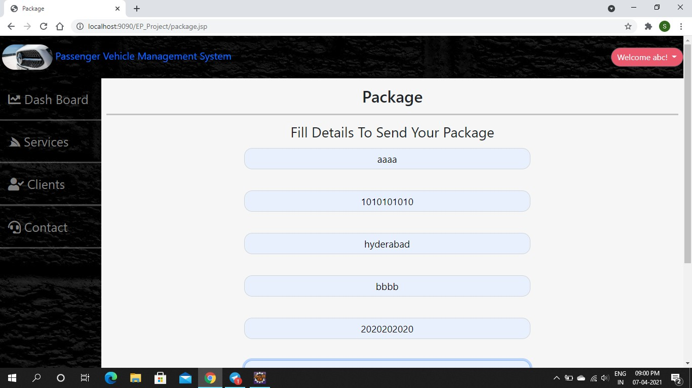
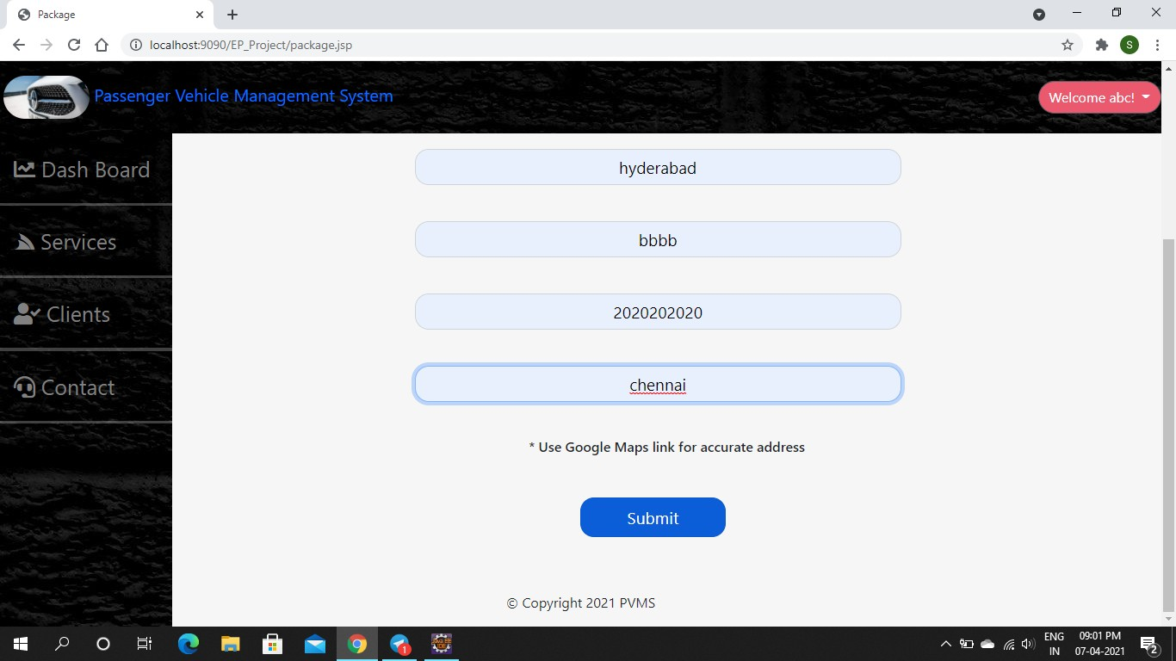
Test Case 1 : Sending A Package
2)
3)

Slide 27
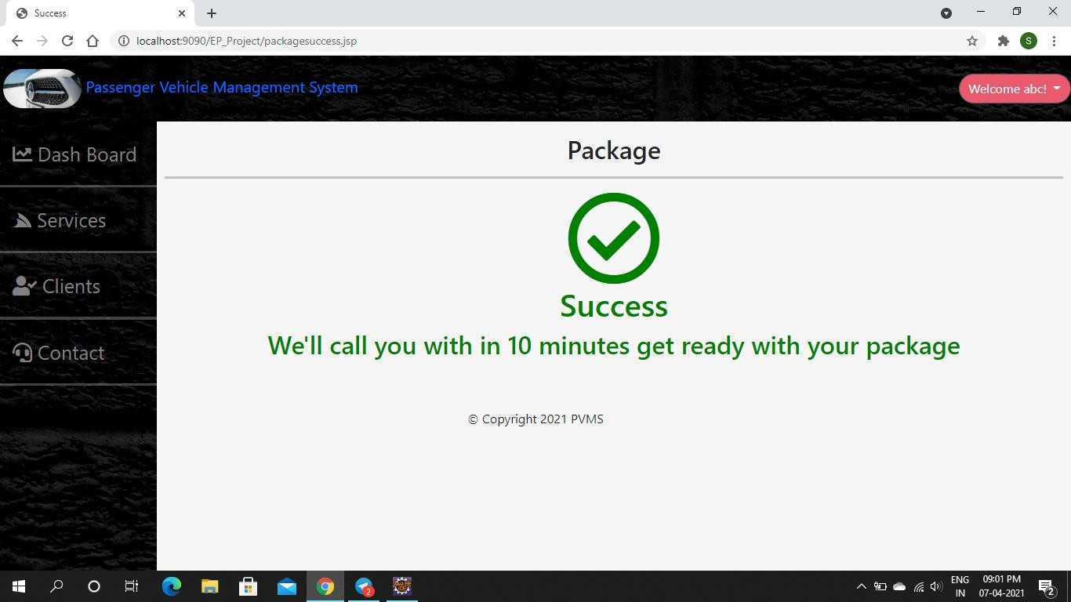
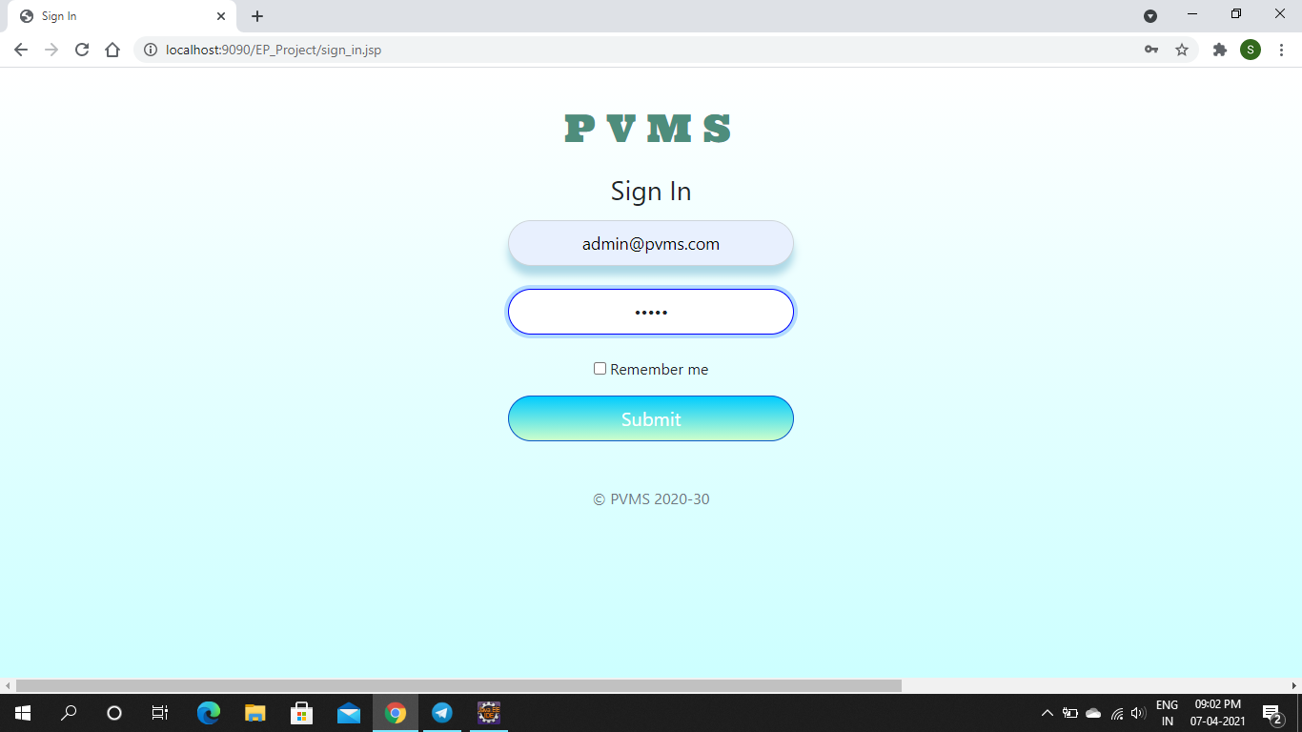
4)
Logging out and checking in Admin’s account

Slide 28
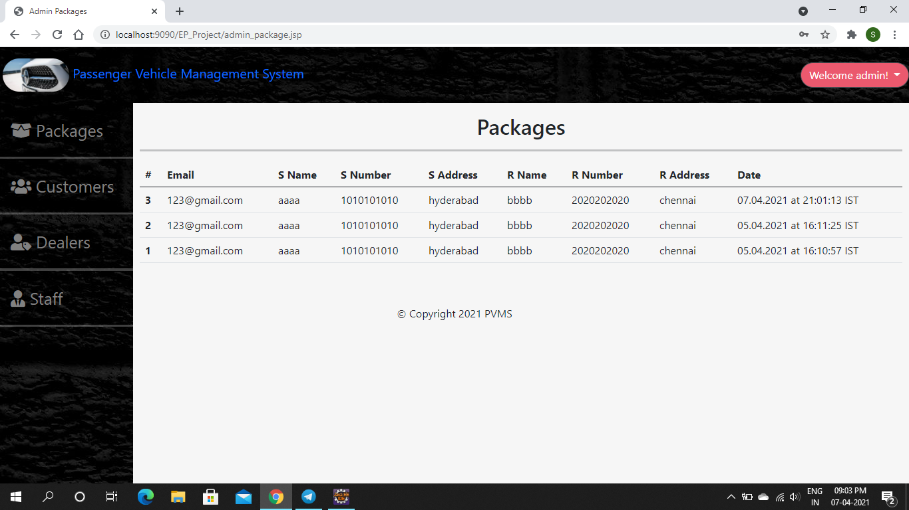
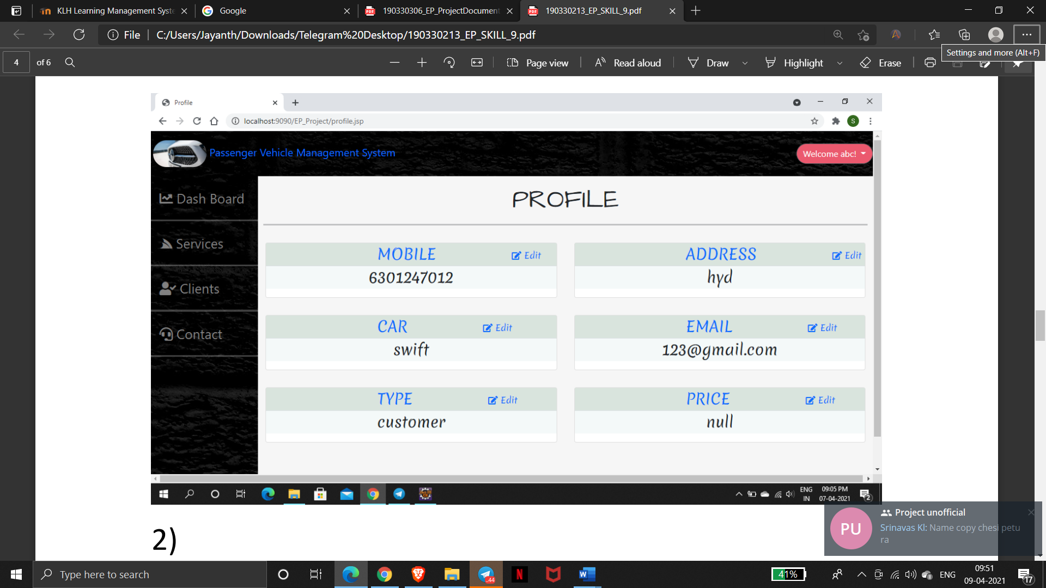
2)
Test Case 2 – Book a Car

Slide 29
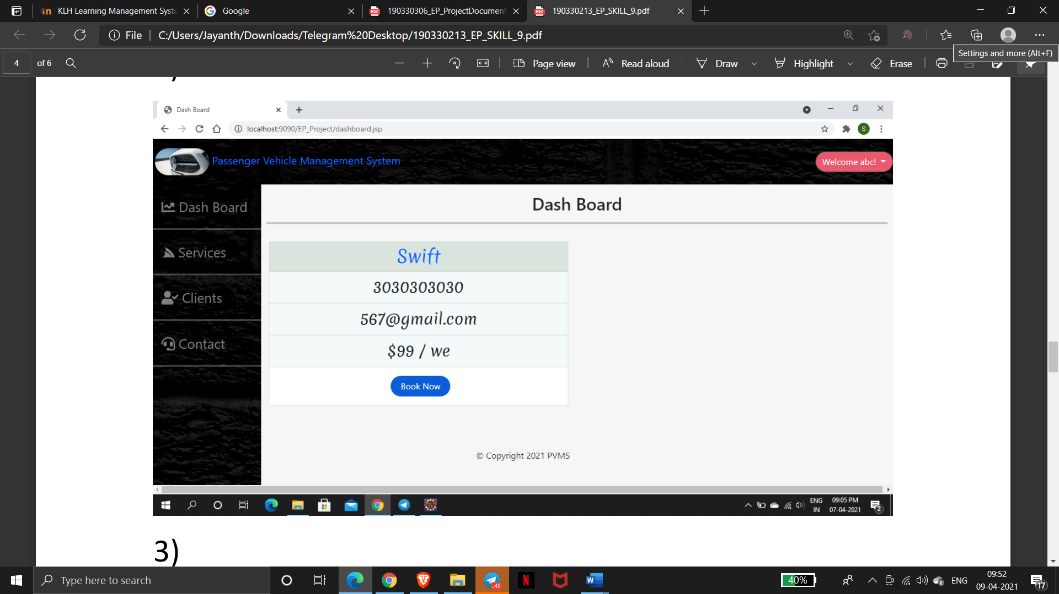
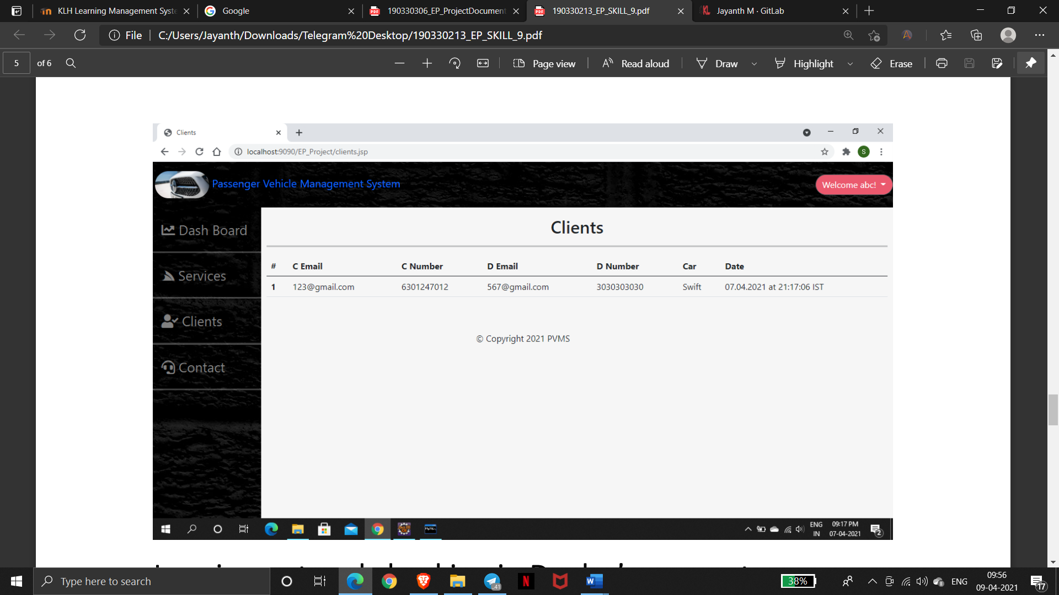

Slide 30
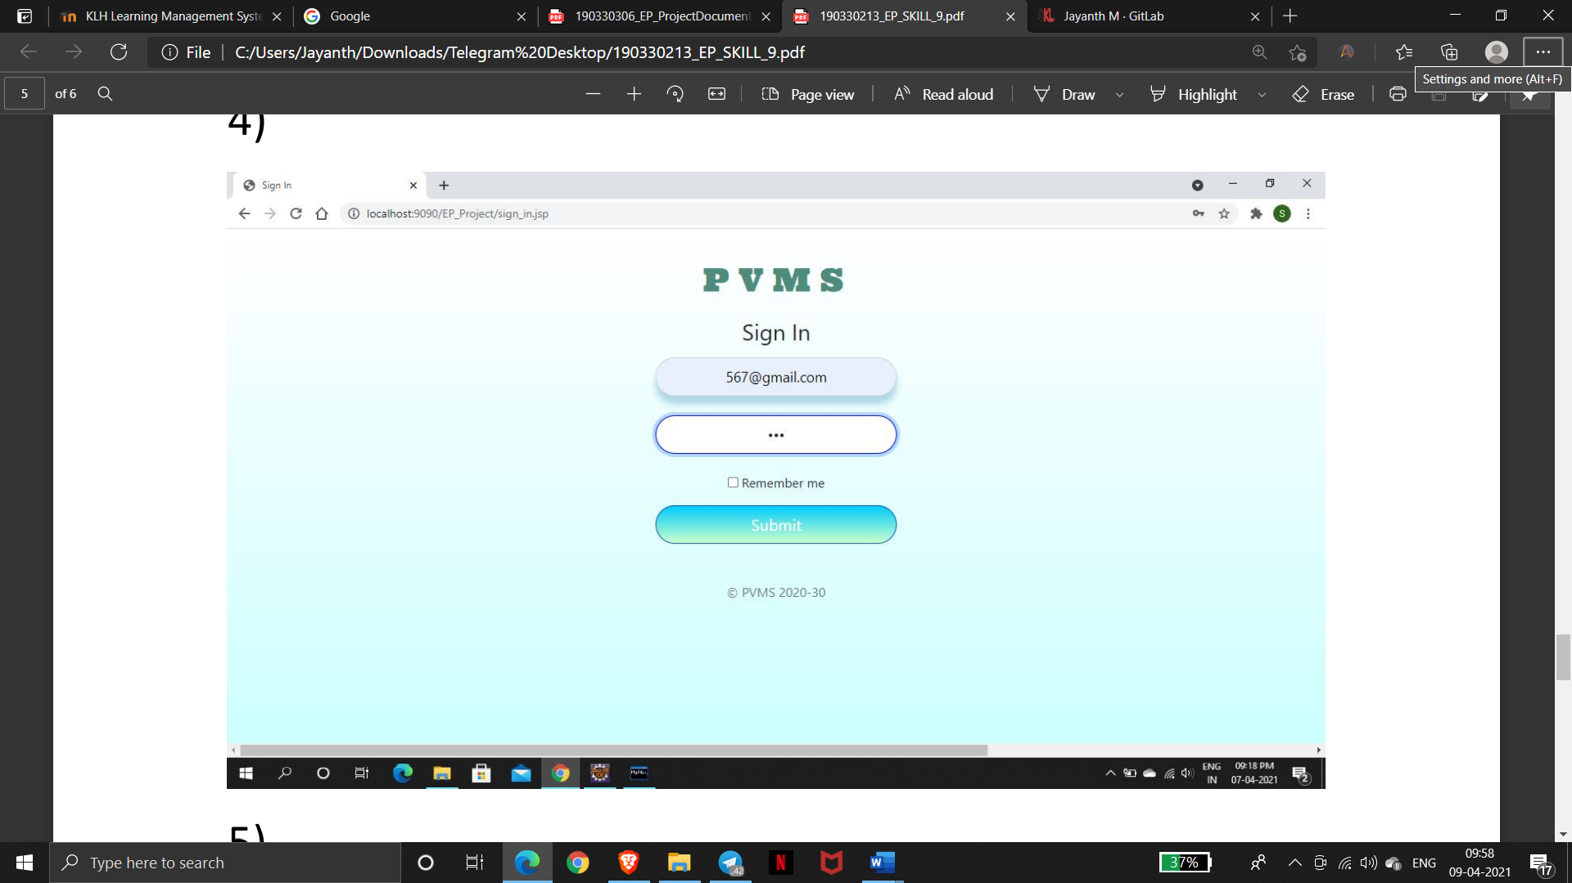
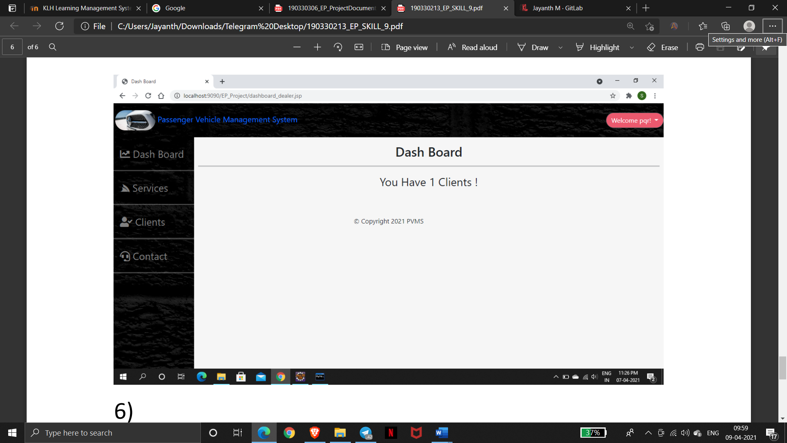
Logging Out and Checking in Dealer’s account

Slide 31
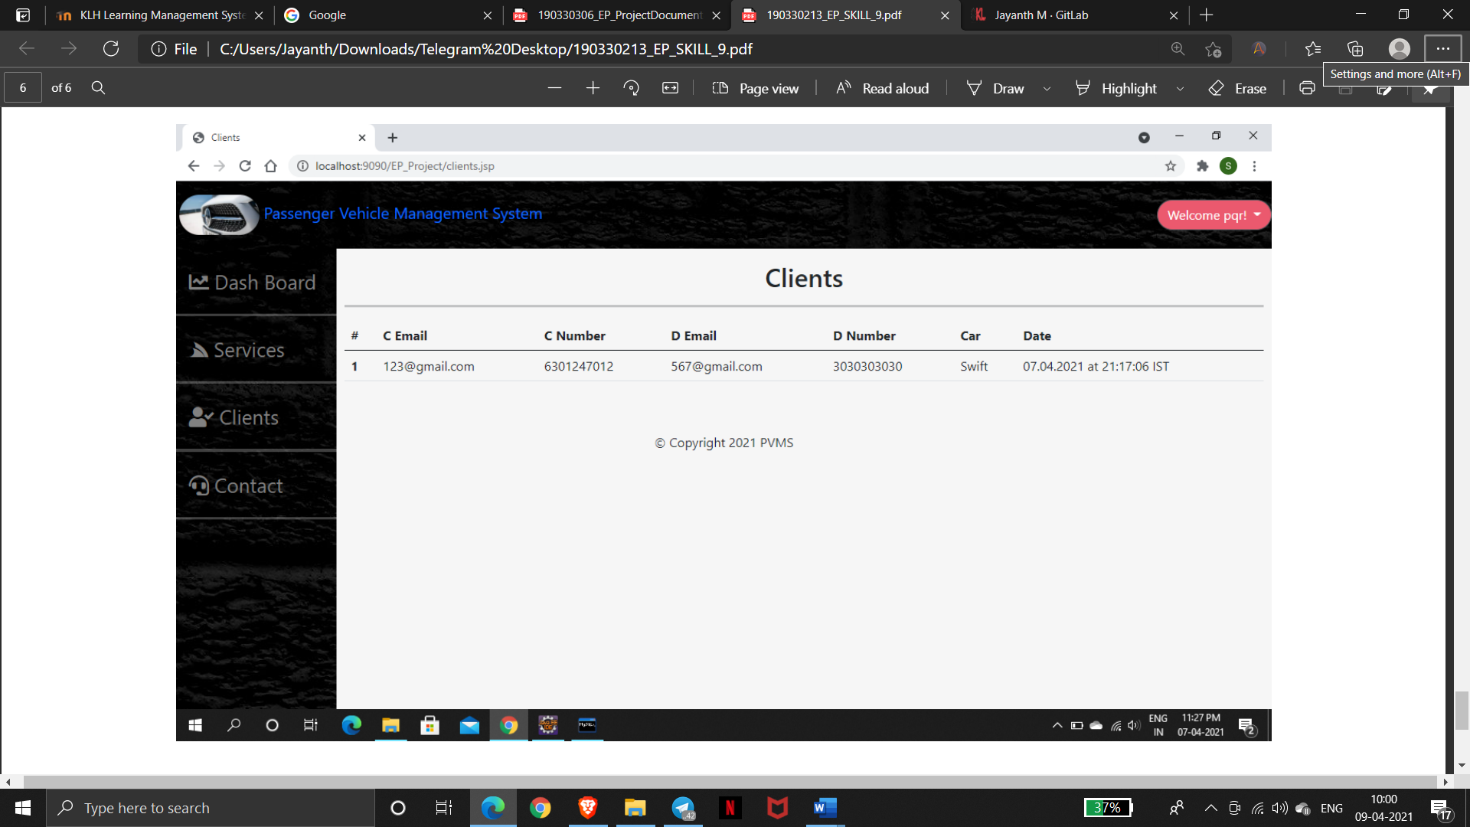

Slide 32


